Slide 1


Word Representations for Named Entity Recognition
http://www.ixa.eus/iltapp/
@ragerri @joseba_fdl @iker_garciaf #iltapp

Slide 2
Contents
Why Named Entity Recognition?
Introduction to the task
Word Representations
Multilingual Language Models
Issues with less-resourced languages
Projecting Heterogeneous Annotations

Slide 3
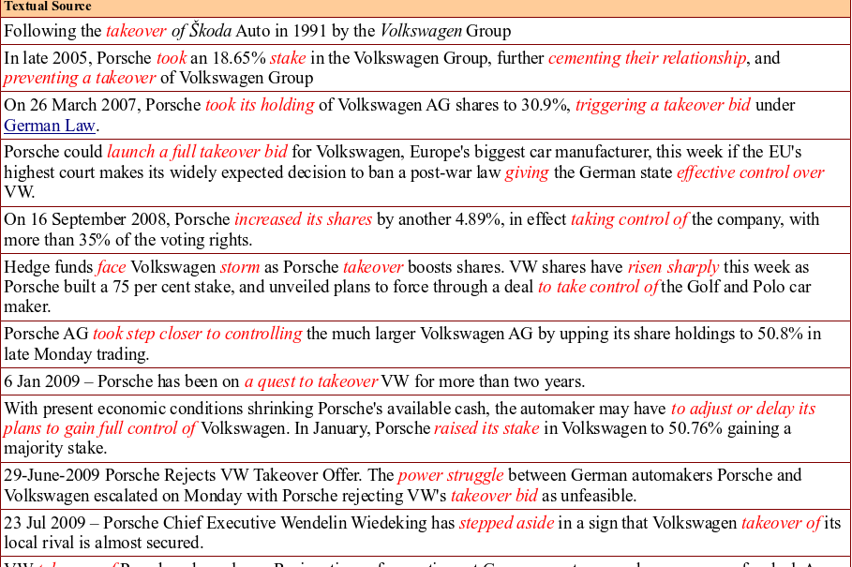
http://www.newsreader-project.eu/

Slide 4
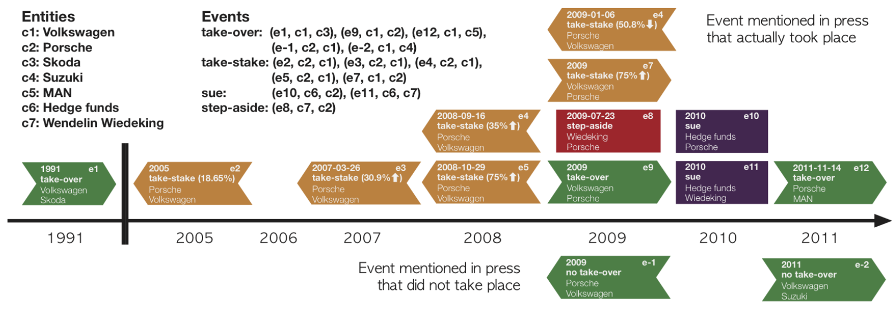
Tasks Overview
http://www.newsreader-project.eu/

Slide 5
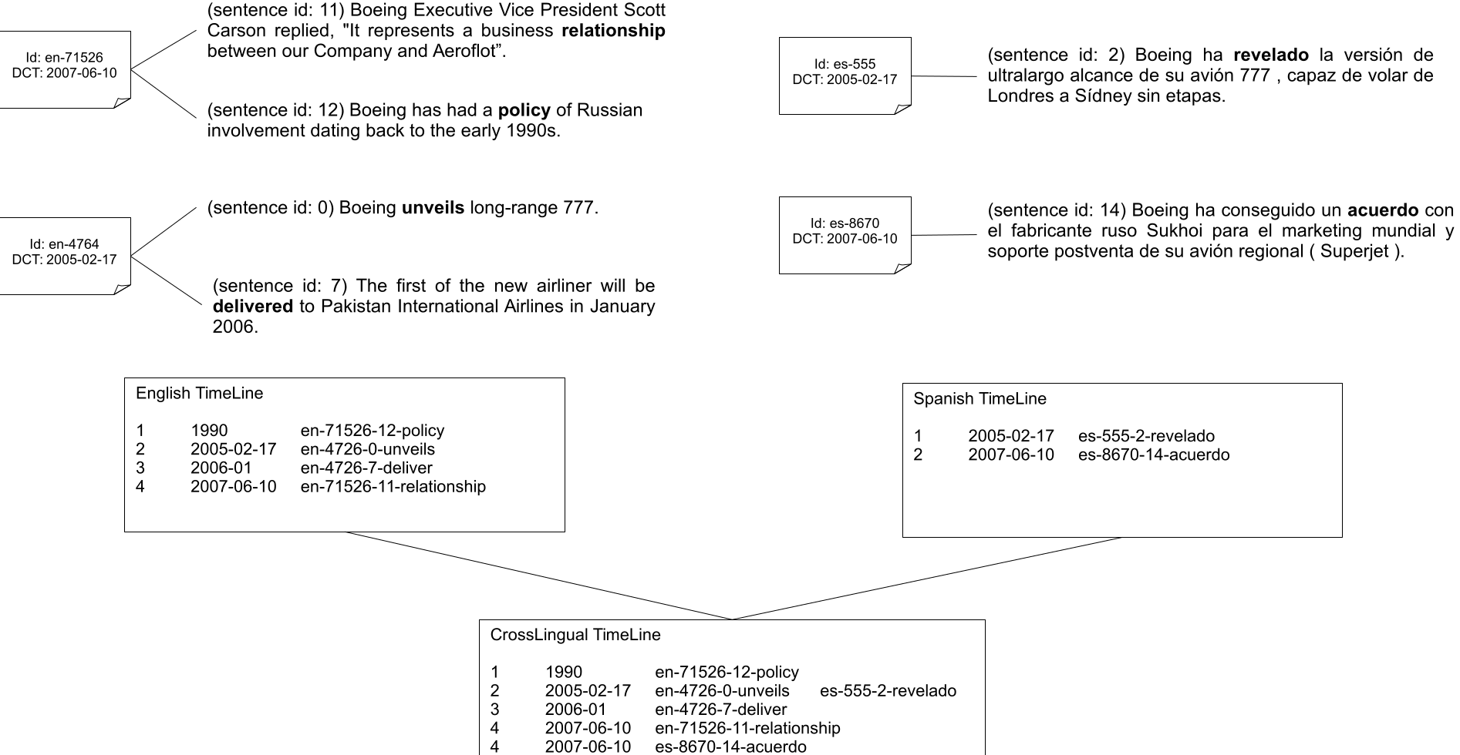
Laparra et al. (2017)

Slide 6
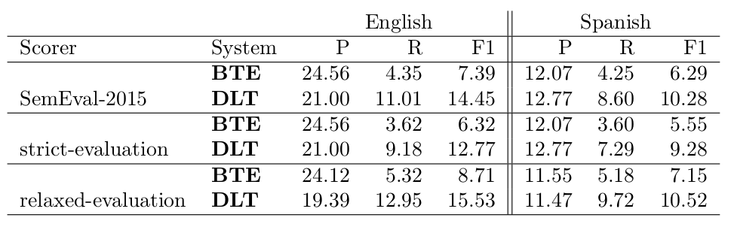
Crosslingual timelines (SOTA)
Laparra et al. (2017)

Slide 7
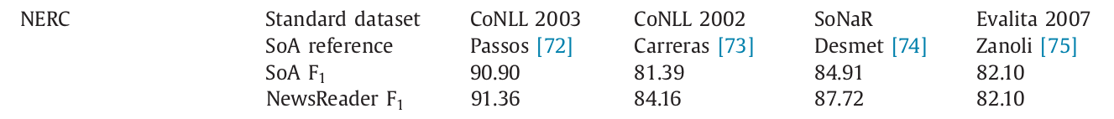
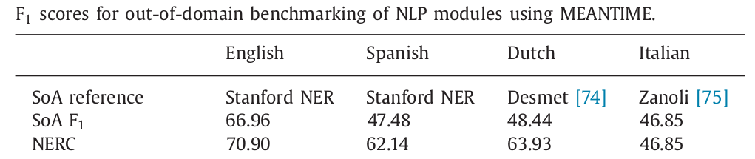
Crosslingual timelines (NER component)

Slide 8
Contents
Why Named Entity Recognition?
Introduction to the task
Word Representations
Multilingual Language Models
Issues with less-resourced languages
Projecting Heterogeneous Annotations

Slide 9
Named Entity Resolution
The disappearance of York University chef Claudia Lawrence is now being treated as suspected murder, North Yorkshire Police said. However detectives said they had not found any proof that the 35-year-old, who went missing on 18 March, was dead. Her father Peter Lawrence made a direct appeal to his daughter to contact him five weeks after she disappeared. His plea came at a news conference held shortly after a 10,000 reward was offered to help find Miss Lawrence. Crimestoppers said the sum they were offering was significantly higher than usual because of public interest in the case.

Slide 10
Named Entity Resolution (NER)
[[The disappearance of [York University chef Claudia Lawrence]] is now being treated as suspected murder, North Yorkshire Police said. However detectives said they had not found any proof that the 35-year-old, who went missing on 18 March, was dead. [Her father Peter Lawrence] made a direct appeal to his daughter to contact him five weeks after she disappeared. His plea came at a news conference held shortly after a 10,000 reward was offered to help find Miss Lawrence. Crimestoppers said [the sum] they were offering was significantly higher than usual because of public interest in the case.

Slide 11
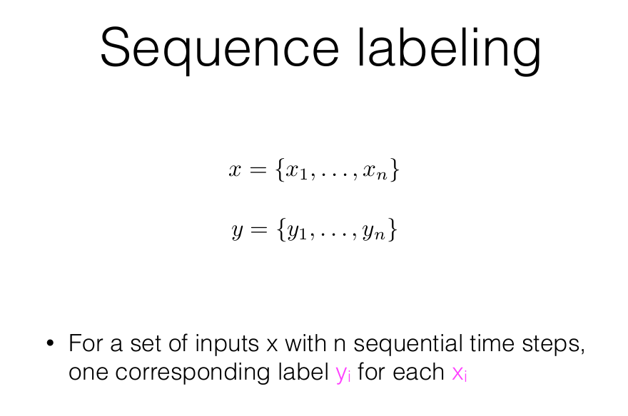
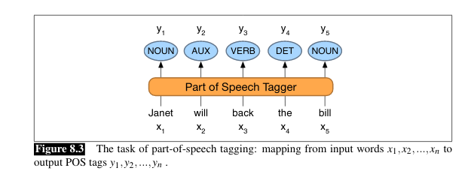
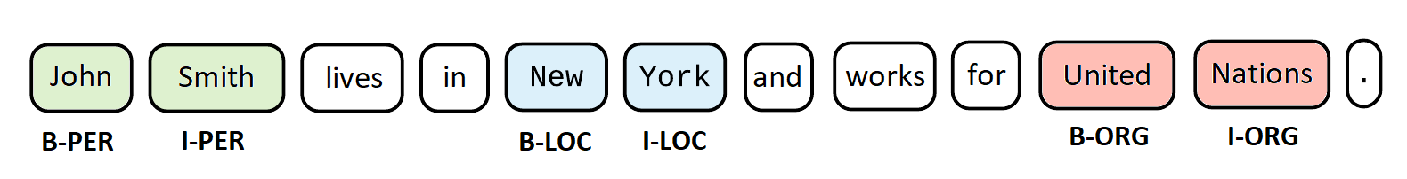

Slide 12
Named Entity Recognition
[tim cook]PER is the ceo of [apple]ORG
Identifying spans of text that correspond to typed entities that are proper names.

Slide 13
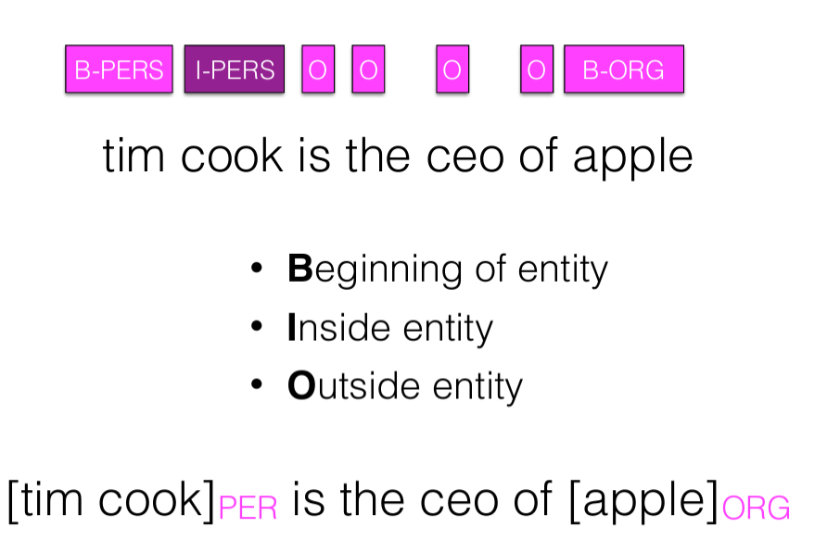
BIO notation

Slide 14
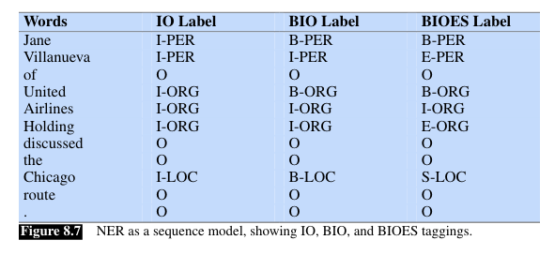
Most common notations
Adapted from Jurafsky and Martin, SLP book, chapter 8.

Slide 15
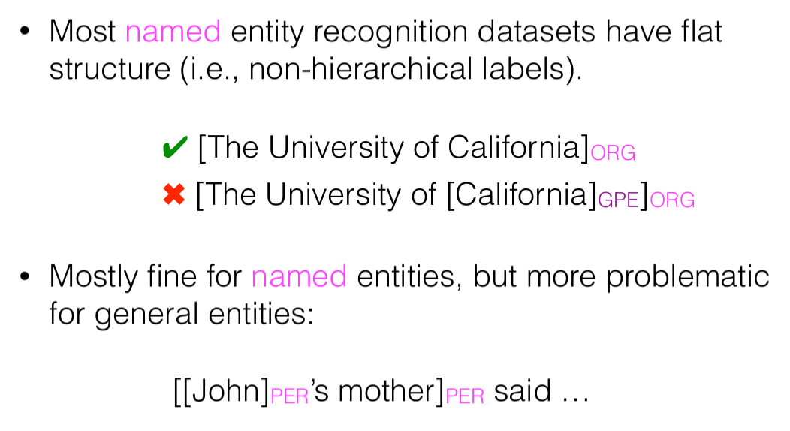
BIO notation

Slide 16
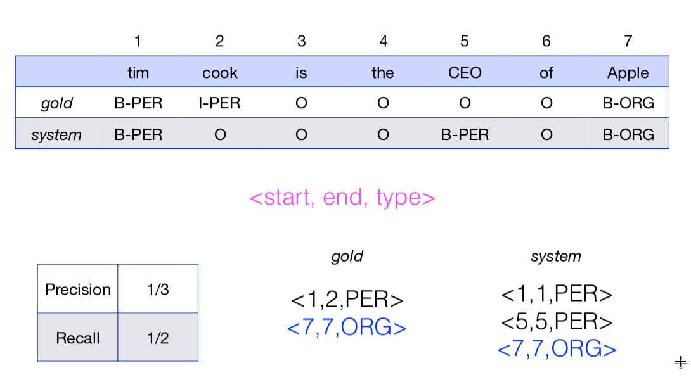
Evaluation

Slide 17
Learning
The classification function that we want to learn has two (main) different components:
the formal structure of the learning method (what’s the relationship between the input and output?) → Naive Bayes, logistic regression, recurrent neural network, etc.
the representation of the data (words?) TODAY - AGAIN!

Slide 18
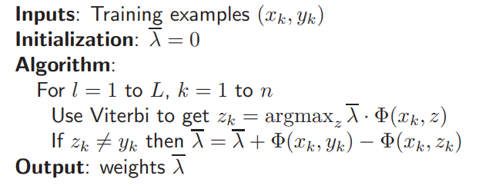
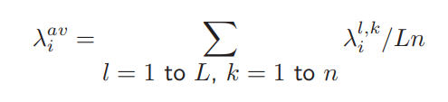
Averaged Perceptron
n sentences for training
Weights initialization = 0
L iterations over training data
For every labeled sentence in training, find the best sequence (z_k) using current weights
If z_k equals to gold sequence, move to next sentence
Otherwise, for every feature in the gold but not in prediction, add 1 to its weight, otherwise substract 1
Average: intermediate weights assigned to every feature is divided by the number of iterations

Slide 19
Contents
Why Named Entity Recognition?
Introduction to the task
Word Representations
Multilingual Language Models
Issues with less-resourced languages
Projecting Heterogeneous Annotations

Slide 20
Word representations
One-hot representation
Distributional Semantic Representations
Static Word Embeddings
Contextual Word Embeddings
Sub-tokens
Characters

Slide 21
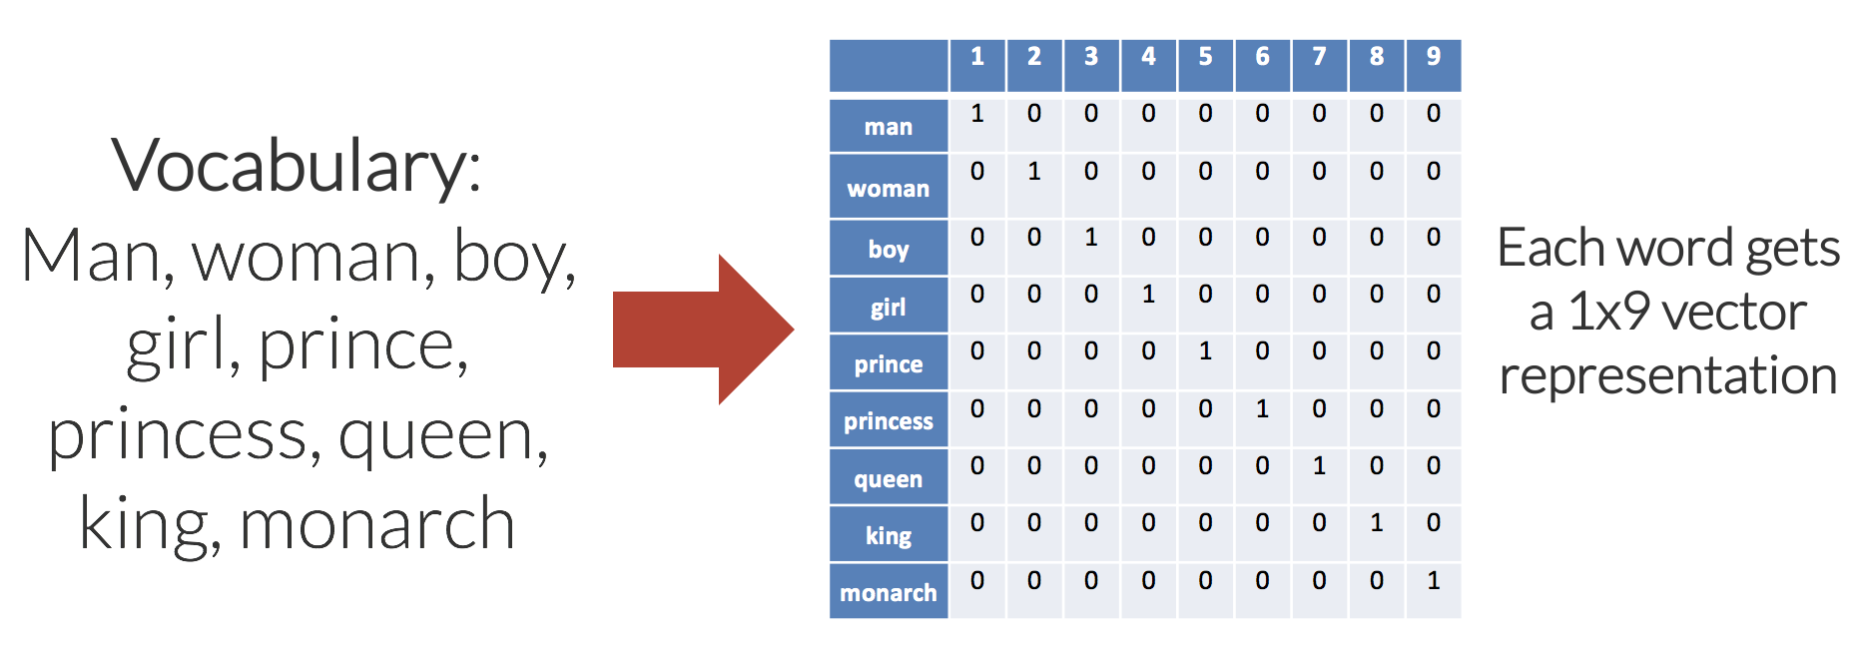
One-hot representation

Slide 22
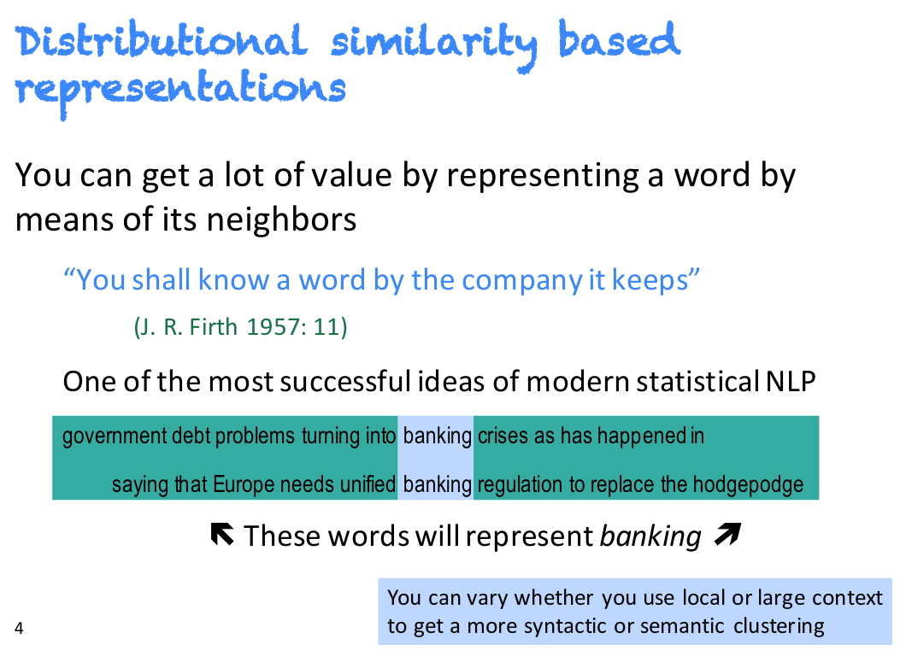
Distributional Semantics
Adapted from Manning CS224n slides

Slide 23
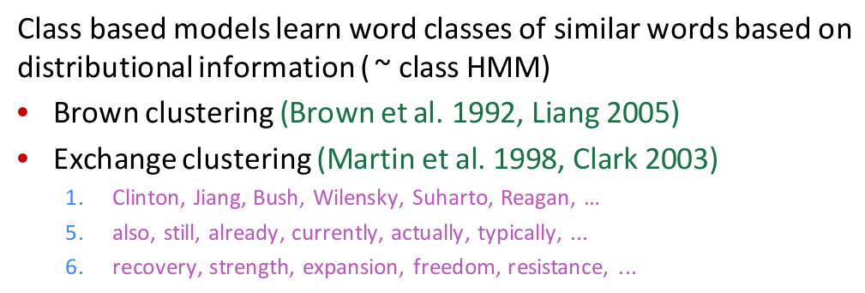
Word Clusters
Adapted from Manning CS224n slides

Slide 24
Distributional representations
Cluster the words in a corpus (dimensions = clusters)
Locatives
Donostiara
Baionara
Zurichera
Gazteizera
Parisera
....
Hospitality
motel
hotel
restaurant
resort
apartment
....
Nature
mountain
hill
ridge
lake
rield
....

Slide 25
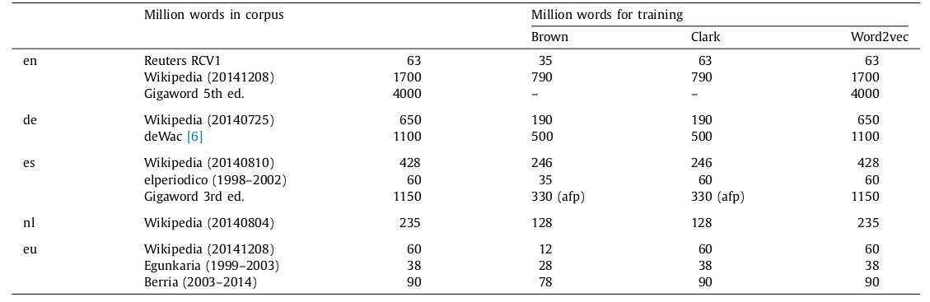
Corpora for cluster training
Agerri and Rigau (2016), In Artificial Intelligence Journal

Slide 26
Clustering-based features
Training
Arabako B-ORG
Foru I-ORG
Aldundia I-ORG
Arabako B-LOC
gobernu O
organoa O
da. O
Gasteizko B-LOC
beste O
erakunde O
batzuekin O
...
Clusters
Test
Morras
Munduko
txapeldun
izan
zen
juniorretan
1994an
Ekuadorko
hiriburuan
,
Quiton.
Arabako
Gasteizko
Espainiako
Ekuadorko
training
Ameriketara
Baionara
Espainiara
...

Slide 27
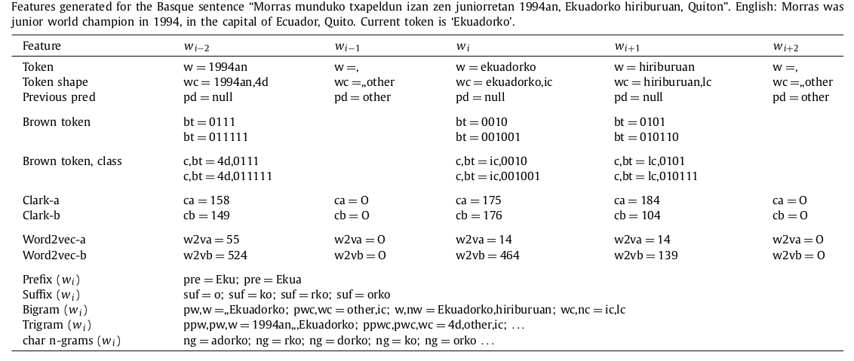
Local Features

Slide 28
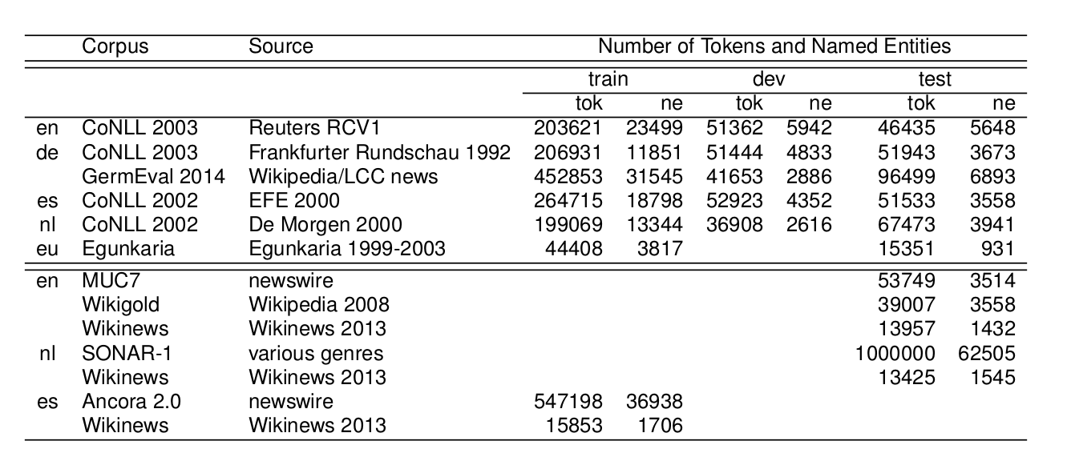
Popular NER datasets
Agerri and Rigau (2016), In Artificial Intelligence Journal.

Slide 29
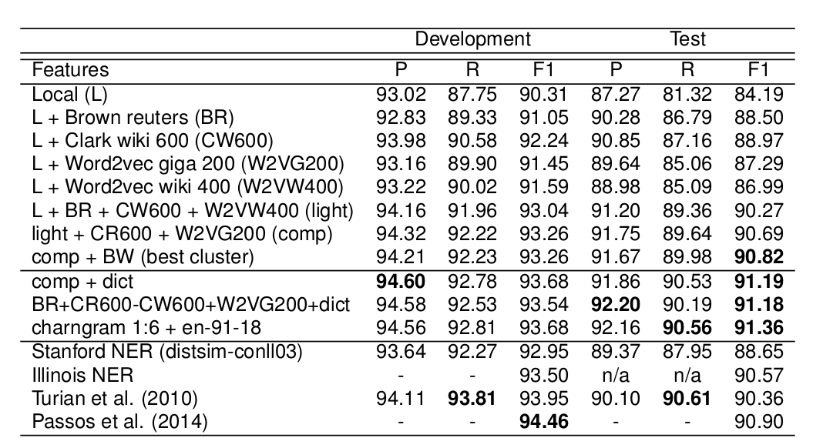
CoNLL 2003 results
Agerri and Rigau (2016), In Artificial Intelligence Journal.

Slide 30
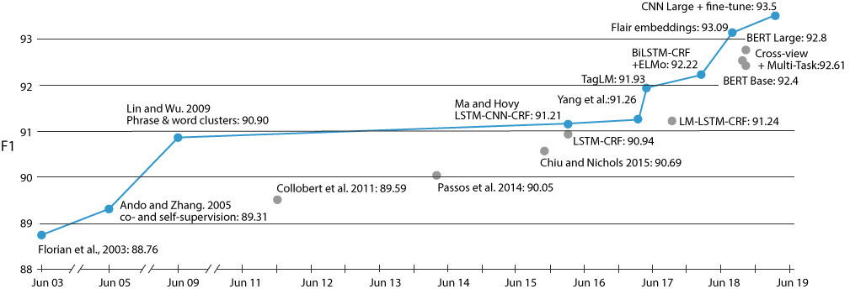
NER (CoNLL 2003) evolution of results
Agerri and Rigau: 91.36
(adapted from NAACL 2019 Transfer learning tutorial)

Slide 31
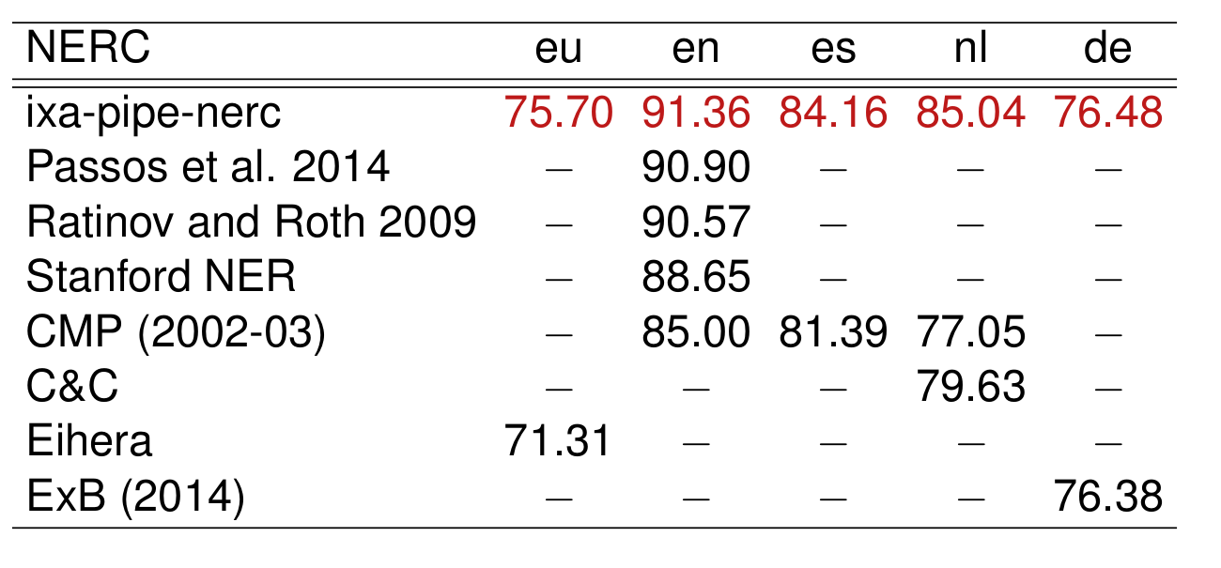
Multilingual results
Agerri and Rigau (2016), In Artificial Intelligence Journal.

Slide 32
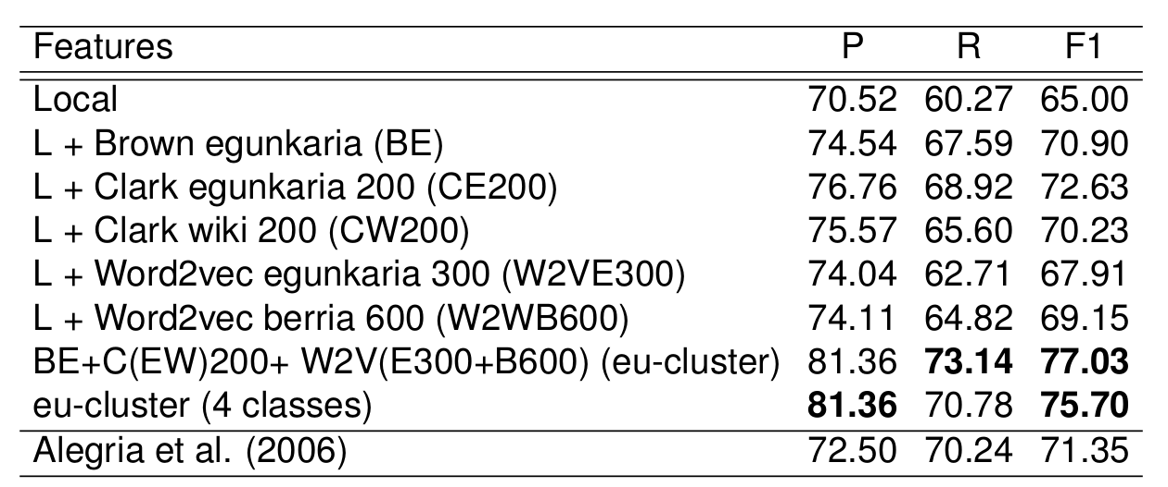
Basque results
Agerri and Rigau (2016), In Artificial Intelligence Journal.

Slide 33
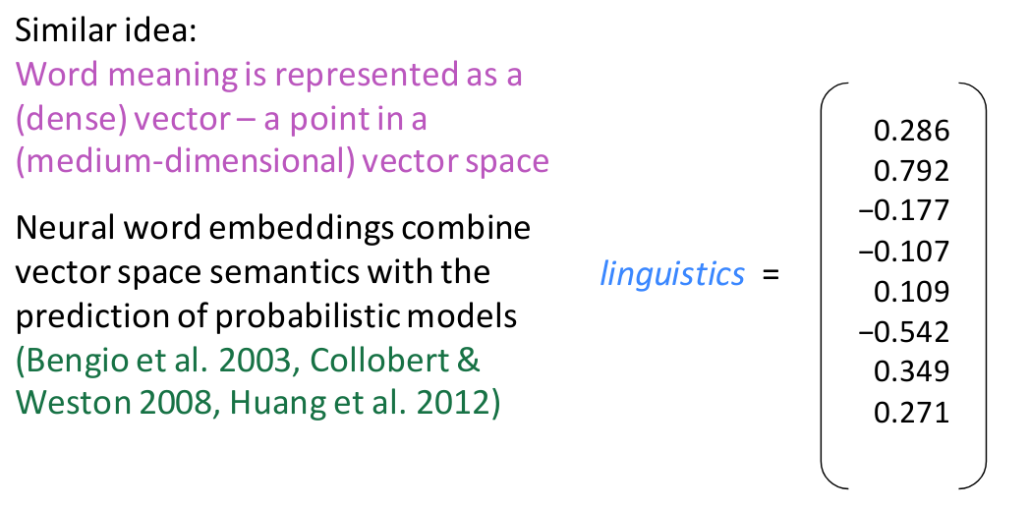
Word Vector Representations
Adapted from Manning CS224n slides

Slide 34
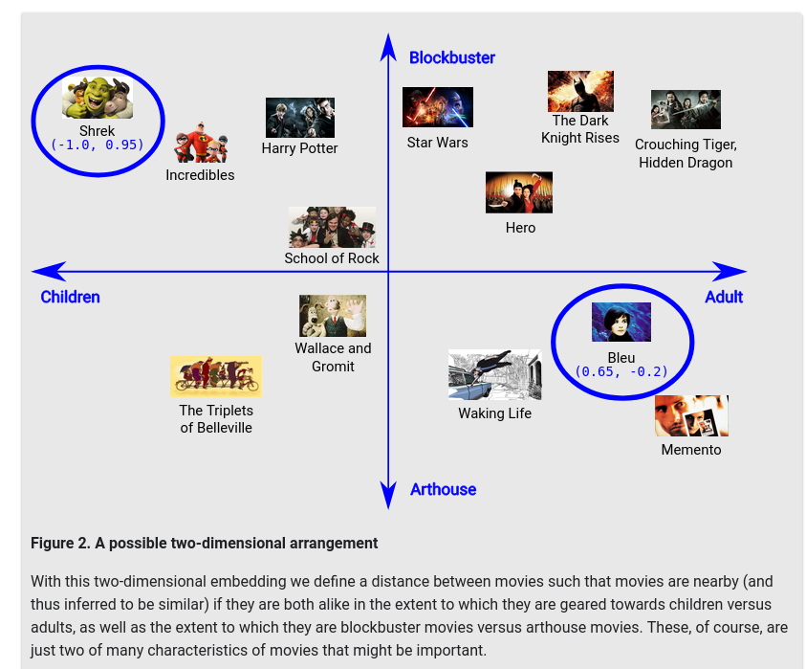
Arranging items along dimensions
These movies are mapped into an embedding space, where each word is described by a two-dimensional set of coordinates.
"Shrek" maps to (-1.0, 0.95) and "Bleu" maps to (0.65, -0.2).
In general, when learning a d-dimensional embedding, each movie is represented by d real-valued numbers, each one giving the coordinate in one dimension.
Latent dimensions: When learning embeddings, the individual dimensions are not learned with names. Sometimes, we can look at the embeddings and assign semantic meanings to the dimensions, and other times we cannot
https://developers.google.com

Slide 35
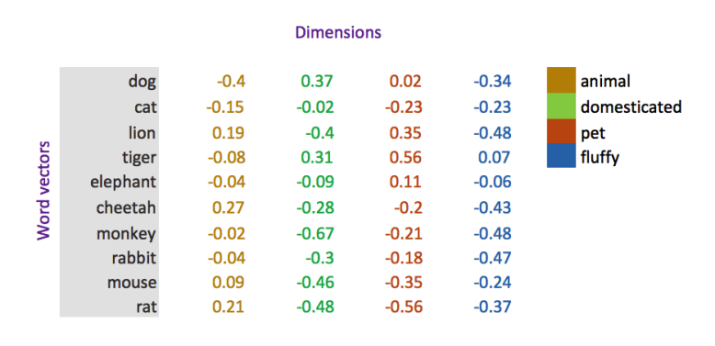
Static Word Vectors
https://projector.tensorflow.org/

Slide 36
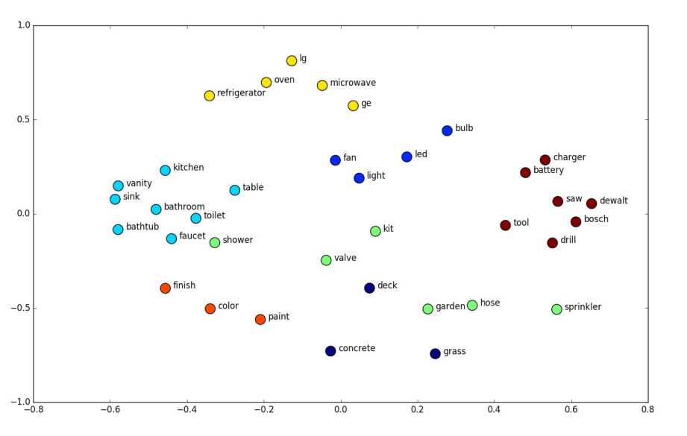
Towards contextual vectors
One vector for each word in a fixed vocabulary

Slide 37
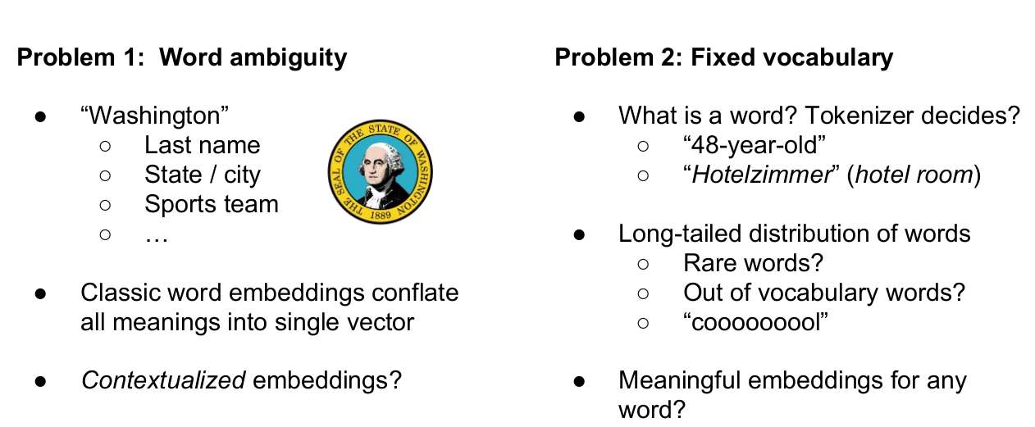
Towards contextual vectors
One vector for each word in a fixed vocabulary
(adapted from Akbik et al. 2018)

Slide 38
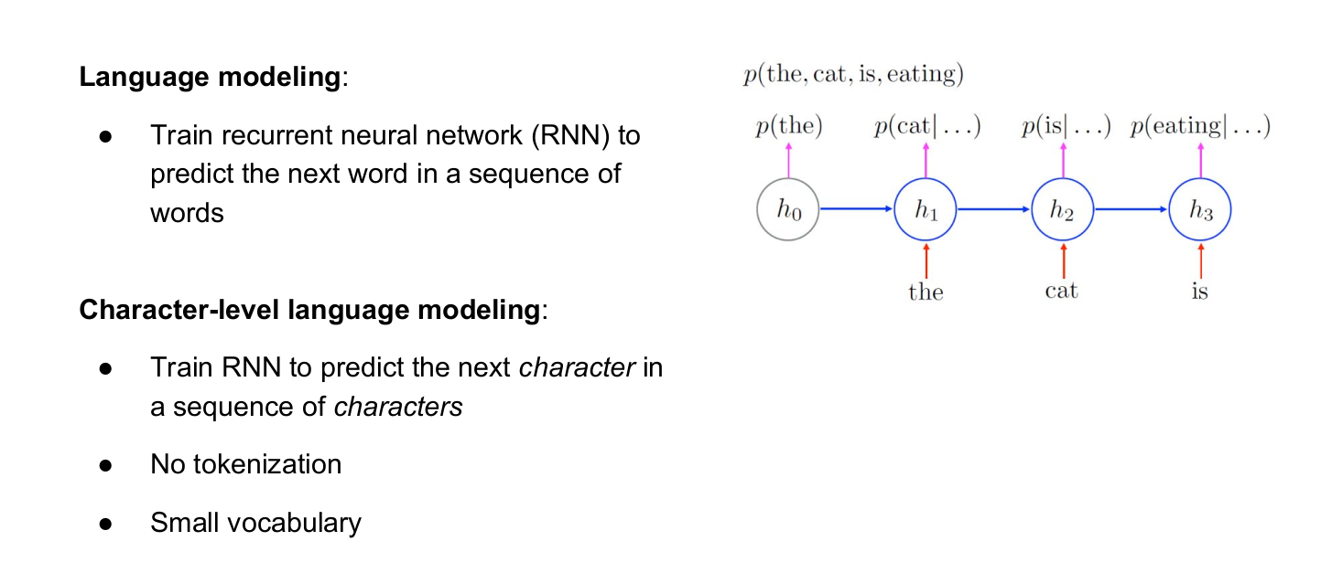
Flair contextual character-based
Akbik et al. 2018. In COLING

Slide 39
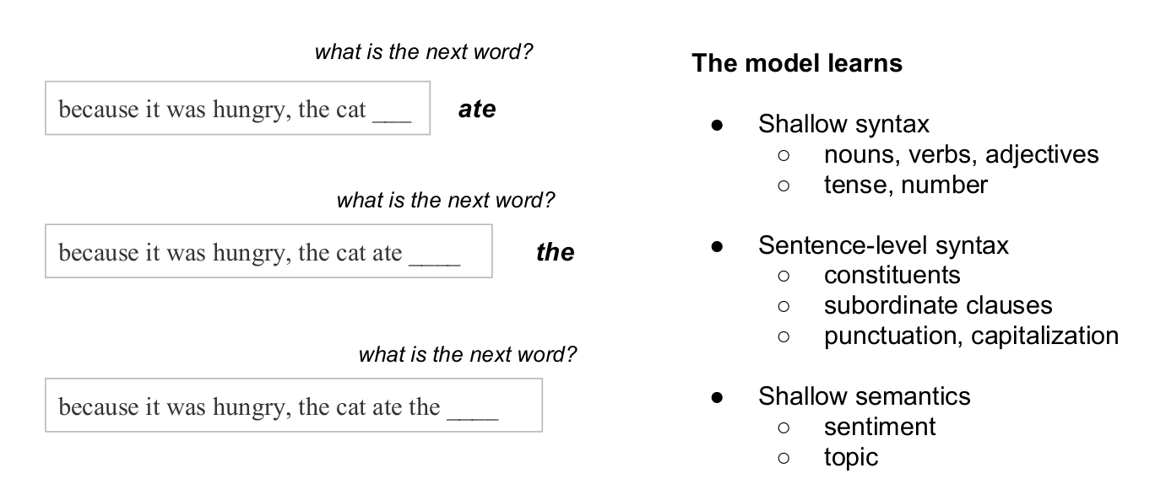
Flair character-based embeddings

Slide 40
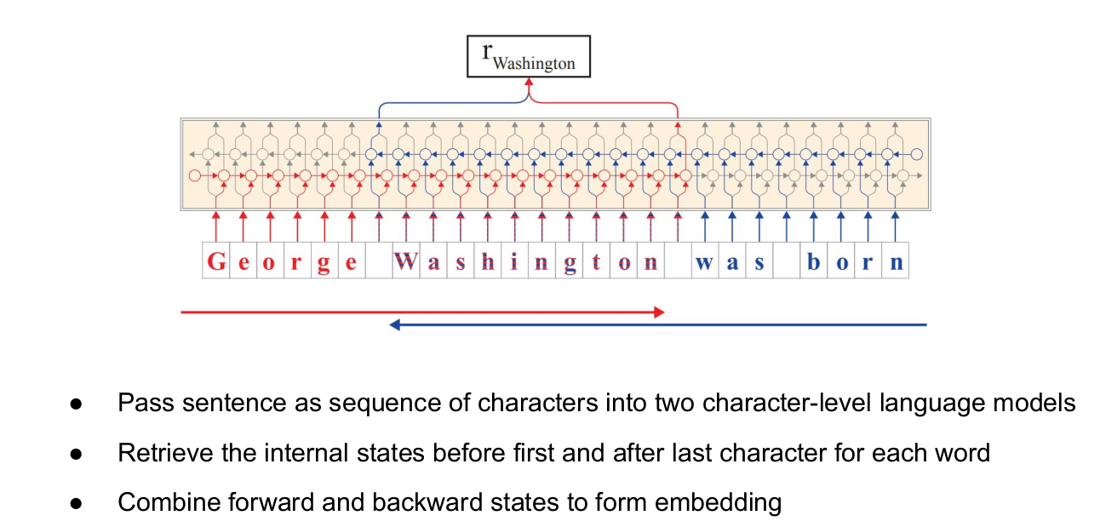
Flair: string-based and contextual
Akbik et al. (2018) In COLING.

Slide 41
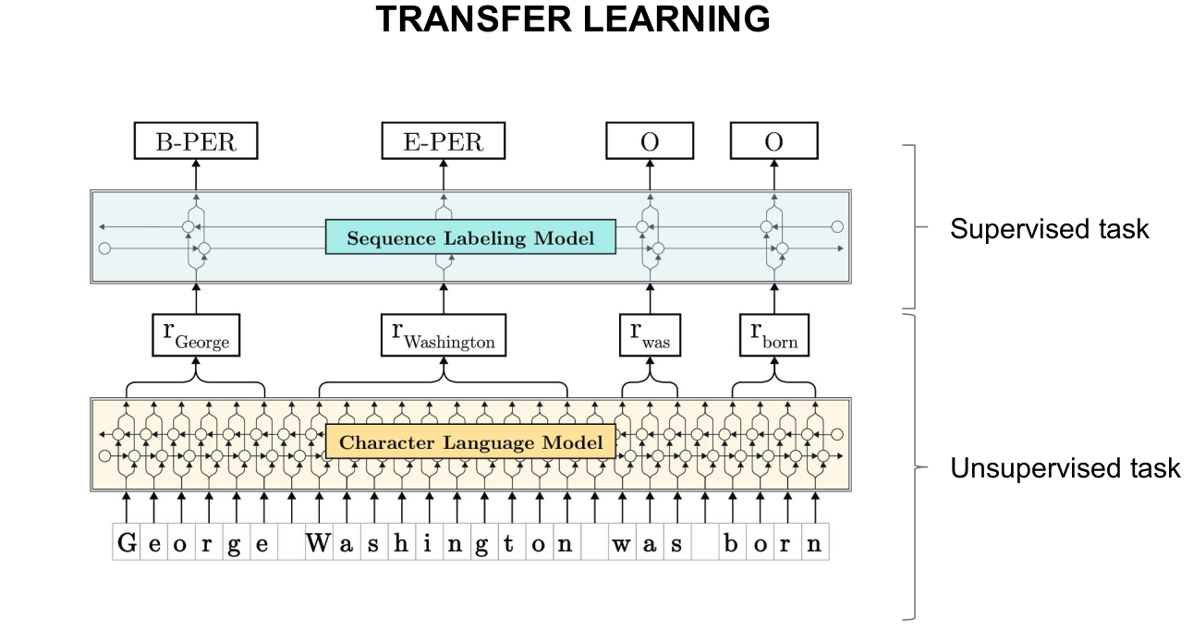
Flair: string-based and contextual
Akbik et al. (2018) in COLING.

Slide 42
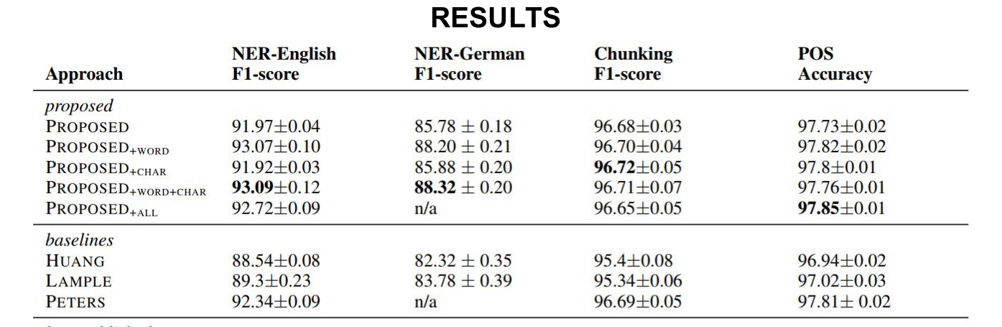
Flair: string-based and contextual
Akbik et al. (2018) in COLING.

Slide 43
NER (CoNLL 2003) evolution of results
Agerri and Rigau: 91.36
(adapted from NAACL 2019 Transfer learning tutorial)

Slide 44
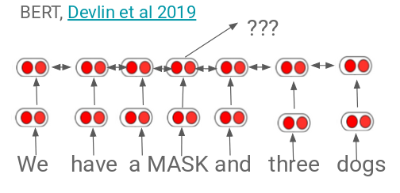
Contextual embeddings (ii)
Instead of learning one vector per word, learn a vector that depends on context
f(play | The kids play a game in the park.)
f(play | The Broadway play premiered yesterday.)

Slide 45
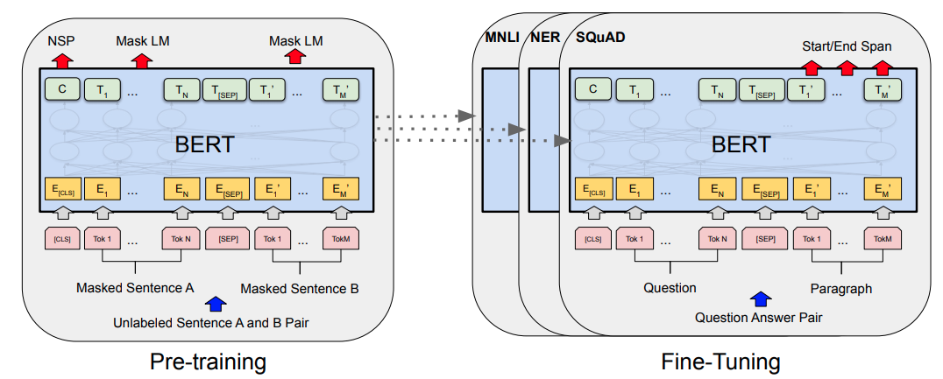
Transformers (BERT)
Devlin et al 2019. In NAACL

Slide 46
NER (CoNLL 2003) evolution of results
Agerri and Rigau: 91.36
(adapted from NAACL 2019 Transfer learning tutorial)

Slide 47
Contents
Why Named Entity Recognition?
Introduction to the task
Word Representations
Multilingual Language Models
Issues with less-resourced languages
Projecting Heterogeneous Annotations

Slide 48
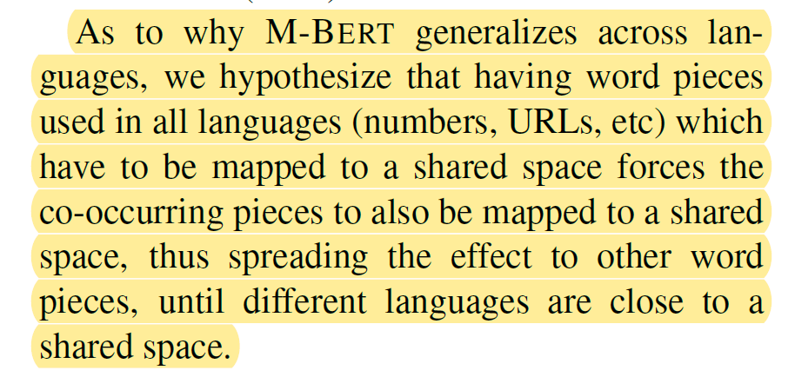
Multilingual BERT
Devlin et al . 2019. In NAACL.

Slide 49
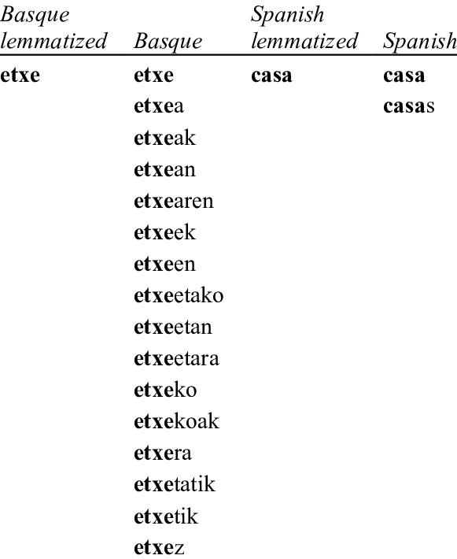
Structural and Lexical differences across languages

Slide 50
Text Representations for Basque
pre-trained language models allow to build rich multilingual representations of text (mBERT, XML-r)
Expensive to train
Suboptimal as less-resourced languages share the quota of substrings and parameters
en-wiki 2.5K million words vs eu-wiki 35 million
Tokenization
mBERT: Medi #kua #rene #ra
BERTeus: Mediku #aren #era (to-the-doctor)
doctor # [the] # to
In Agerri et al. Give your text representation models some love: the case of Basque. In LREC 2020.

Slide 51
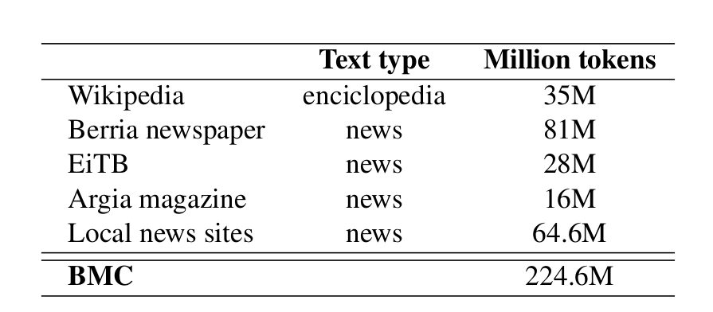
Basque Media Corpus (BMC)
In Agerri et al. Give your text representation models some love: the case of Basque. In LREC 2020.

Slide 52
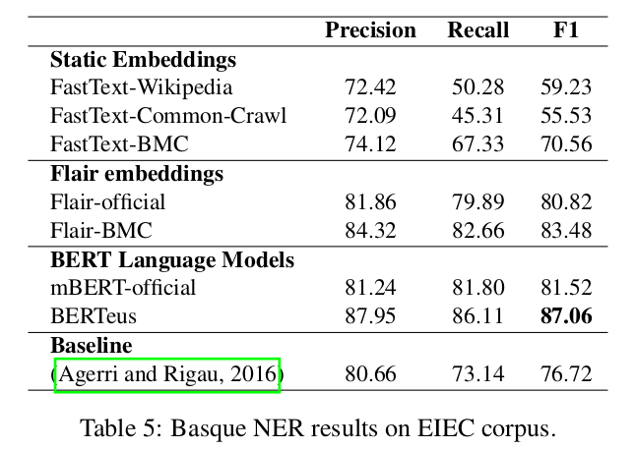
Basque NER state of the art
In Agerri et al. Give your text representation models some love: the case of Basque. In LREC 2020.

Slide 53
Multilingual Transformers
Share vocabulary and representations across languages by training one model on many (100+) languages.
Enables cross-lingual pretraining by itself
Leads to under-representation of low-resource languages (Agerri et al. 2020)

Slide 54
Contents
Why Named Entity Recognition?
Introduction to the task
Word Representations
Multilingual Language Models
Issues with less-resourced languages
Projecting Heterogeneous Annotations

Slide 55
Combine and project
Spanish NER shared task 2020:
1M corpus annotated by the Academy of the Spanish Language (RAE)
Our approach:
Flair LMs: Oscar corpus, Gigaword+Wikipedia
Transformers: Bertin (Gigaword+Wikipedia), XLM-RoBERTa (Common Crawl) and mBERT (Wikipedia + books)
Project annotations (various strategies)

Slide 56
Experimental Setup
Flair pre-trained Spanish LM
Wikipedia
Public pre-trained Transformer LMs:
BETO (various sources)
XLM-RoBERTa (Common Crawl 2.5TB)
mBERT (Wikipedia + books)
Our own LMs:
Flair-GW: GigaWord + Wikipedia (11GB)
Flair-Oscar: Oscar Spanish Corpus (157GB)
Project annotations

Slide 57



5-1 projections
LM sources
NER models
predicted data
projected prediction
fine-tune
predict
mBERT, XLM-R, Flair...

Slide 58
Projecting Annotations
Condition | Decision
4 > agreement | Keep Label
=< 3 agreement | Backoff:
 | No Prediction (O) Trust one system Use probability scores
> 1.5 F1 score improvement over best individual system
Heterogeneity of systems/sources crucial

Slide 59
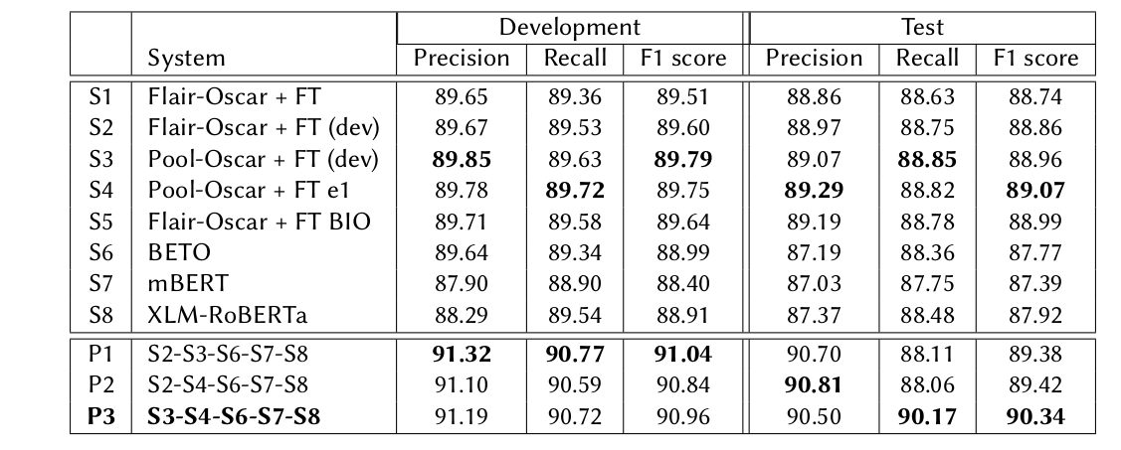
Results
> 1.3 F1 score improvement over best individual system

Slide 60
Mila esker!
Thanks!

Slide 61
References
Rodrigo Agerri, Iñaki San Vicente, Jon Ander Campos, Ander Barrena, Xabier Saralegi, Aitor Soroa and Eneko Agirre (2020). Give your Text Representation Models some Love: the Case for Basque. In LREC 2020.
Rodrigo Agerri, German Rigau, Robust multilingual Named Entity Recognition with shallow semi-supervised features. Artificial Intelligence, 238 (2016) 63-82.
Akbik, A., Blythe, D., and Vollgraf, R. (2018). Contextual string embeddings for sequence labeling. In COLING 2018.
Devlin, J., Chang, M.-W., Lee, K., and Toutanova, K. (2019). BERT: Pre-training of Deep Bidirectional Transformers for Language Understanding. In NAACL 2019.
Grave, E., Bojanowski, P., Gupta, P., Joulin, A., and Mikolov, T. (2018). Learning word vectors for 157 languages. In LREC 2018.
Egoitz Laparra, Rodrigo Agerri, Itziar Aldabe, German Rigau. Multi-lingual and Cross-lingual timeline extraction. Knowledge-Based Systems, 133, 77-89, 2017

